Slide 1



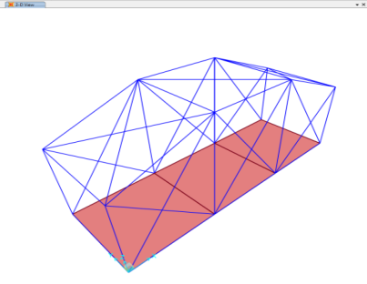
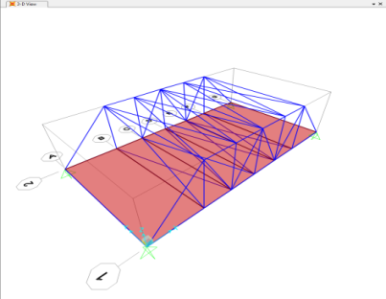
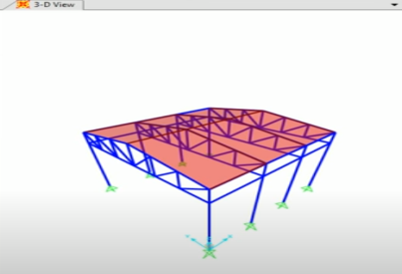
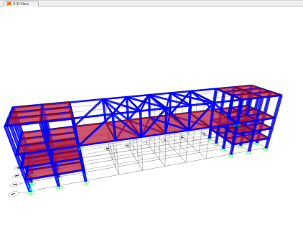
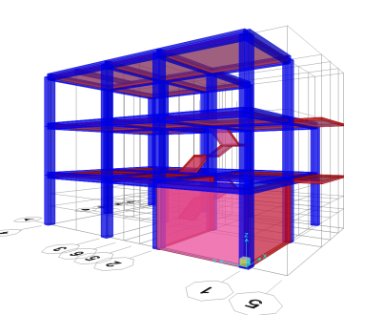
Structure Super Combo
Design and Construction Society , IITK
Abstract
Designing The Structures
Introduction to SAP2000
The aim of the project was to learn Basic of Designing (buildings, bridges, etc.) through general-purpose civil engineering software called SAP2000 which is mainly used for analyzing and designing structural systems. The project was divided in two half , covering Trusses in first half while Beam Theory in latter one.
Truss Theory covered the basic of designing ( building , bridges etc.) using SAP2000 , discussing various methods of Trusses , applied Dead load and wind load on Tin shed, Modeling Truss Bridges ,introducing to shear forces and bending moments diagrams , manually adjusting steel and concrete properties and finally ensuring that both deformation and cost of the structure should be minimized. Beam Theory covered a very crucial part of modeling a residential building taking various kinds of loads(such as ,live load ,parapet wall load ,floor finish , earthquake loads) into consideration. Concepts like Diaphragm , Meshing of Slabs were introduced to prevent building’s stability.
The most important part is to check if the all the members of frame section pass the stress/capacity check and lastly , ensuring that all the other parameters are within permissible limit. We got the basic acumen of analysing structures and learned how to use SAP2000 in modeling and designing of complex structures like building , sky walk , Bridges etc.
SAP2000 is a stand-alone finite-element-based structural program for the analysis and design of civil structures. It offers an intuitive, yet powerful user interface with many tools to aid in the quick and accurate construction of models, along with the sophisticated analytical techniques needed to do the most complex projects.SAP2000 is object based, meaning that the models are created using members that represent the physical reality. A beam with multiple members framing into it is created as a single object, just as it exists in the real world, and the meshing needed to ensure that connectivity exists with the other members is handled internally by the program.
Trusses
a truss is a structure that "consists of two-force members only, where the members are organized so that the assemblage as a whole behaves as a single object“ . A "two-force member" is a structural component where force is applied to only two points. trusses typically comprise five or more triangular units constructed with straight members whose ends are connected at joints referred to as nodes.
Members
Janhavi Bhoge
Yuvraj Mimrot
Keyur Panchal
Khusbhu
Sanidhya Shrivastava
Mentors
Bidhan Arya
*All above structures are application of Trusses
Beams beams, in structural engineering terms, is a member that can be comprised of a number of materials ( including steels , wood Aluminium) to withstand loads which are applied laterally to beam axis.
*All above structures are application of Beams and Columns

